Slide 1
FACE MASK DETECTION
With Python,OpenCv,Keras.

Slide 2
What is Face Mask Detection..?
Face mask detection using deep learning: An approach to reduce risk of Coronavirus spread.
Face mask detection refers to detect whether a person is wearing a mask or not.
The task is to a develop technique that can accurately detect mask over the face in public areas (such as airports. railway stations, crowded markets, bus stops, etc.) to curtail the spread of Coronavirus and thereby contributing to public healthcare.

Slide 3
Why is Face Mask Detection needed..?
Public Transport : Wearing face masks in public transport will be mandatory in many parts of the world. Public transport organizations can use the software to automate the checking process with very little resources needed with efficiency.
Hospitality : Hotels, restaurants and bars are opening their doors to the public with certain regulations. In many cases, visitors will be required to wear masks when checking in or interacting with the staff. To ensure a smooth and safe visitor experience.
Airports : Face mask detector can be very effectively used at airports mainly for entrance flow management and monitoring. The software can be added to any access gate or entrance to make sure that all the passengers follow the safety rules when boarding a plane.

Slide 4
How to build face mask detection?
Step 1 : Data Visualisation:
In the first step, let us visualise the total number of images in our dataset in both categories. We need to classify the images with mask and without mask.
Step 2 : Training:
Here we’ll focus on loading our face mask detection dataset from disk, training a model (using Keras/TensorFlow) on this dataset, and then serializing the face mask detector to disk
Step 3 : Deployment:
Once the face mask detector is trained, we can then move on to loading the mask detector, performing face detection, and then classifying each face as with_mask or without_mask

Slide 5
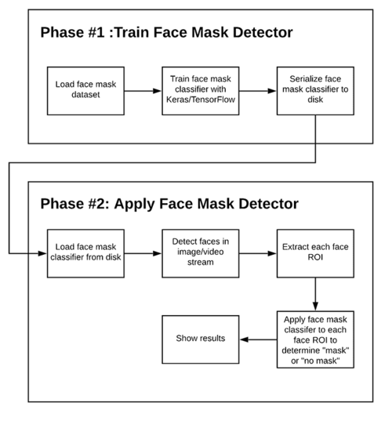

Slide 6
THANK YOU!
Presented By:
O.Uttej Reddy.

